Slide 1
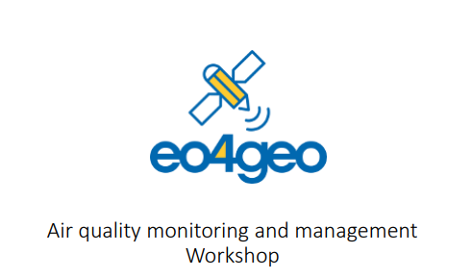

EO data to support estimation of wildfires atmospheric emissions: a contribution to the assessment of the air quality
ISPRA
Antonella Tornato, Federico Filipponi

Slide 2
TABLE OF CONTENT
Framework
Air Quality Operational Service
National operational Services
Example of environmental needs
ECMWF and Italian Copernicus Mirror Programme
Copernicus Atmosphere Monitoring Service (CAMS)
Development downstream services
Case study in Italy

Slide 3
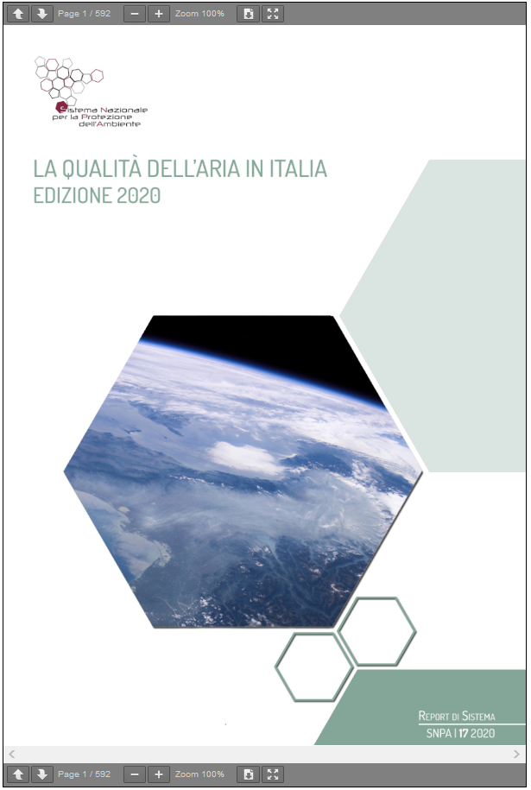
FRAMEWORK
In European legislation, air quality (AQ) management is the responsibility of the member states (MS) who must guarantee to citizens the compliance with the limit values (LV) set by the European Union (EU).
Ambient Air Quality Directive, adopted as 2008/50/EC
[PM2.5, PM10, SO2, NO2, Pb, Co, Benzene, O3, As, Cd, Ni, Benzo(a)pirene]
The Italian legislation, transposing the European directive (D. Lgs. 155/2010, subsequent amendments and additions), has delegated the AQ competences to the Regions and Autonomous Provinces. Regions/ Autonomous Provinces are supported by the regional environmental agencies (ARPA/APPA), organized in the National Environmental Protection System – SNPA, to obtain the data and information necessary for the exercise of their responsibilities. The central government, through the Ministry of Ecological Transition (MiTE), is supported by National Institute for Environmental Protection and Research (ISPRA) and National Agency for new technologies energy and sustainable economic development (ENEA).
Notes:
The Italian legislation has delegated the Ambient Air Quality Directive competences to the Regions and Autonomous Provinces, supported by the National Environmental Protection System.
The Ambient Air Quality Directive provides the current framework for the control of ambient concentrations of air pollution in the EU. The control of emissions from mobile sources, improving fuel quality and promoting and integrating environmental protection requirements into the transport and energy sector are part of these aims.

Slide 4
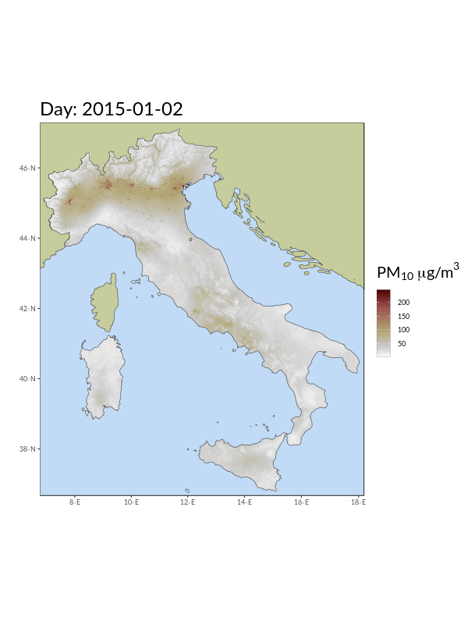
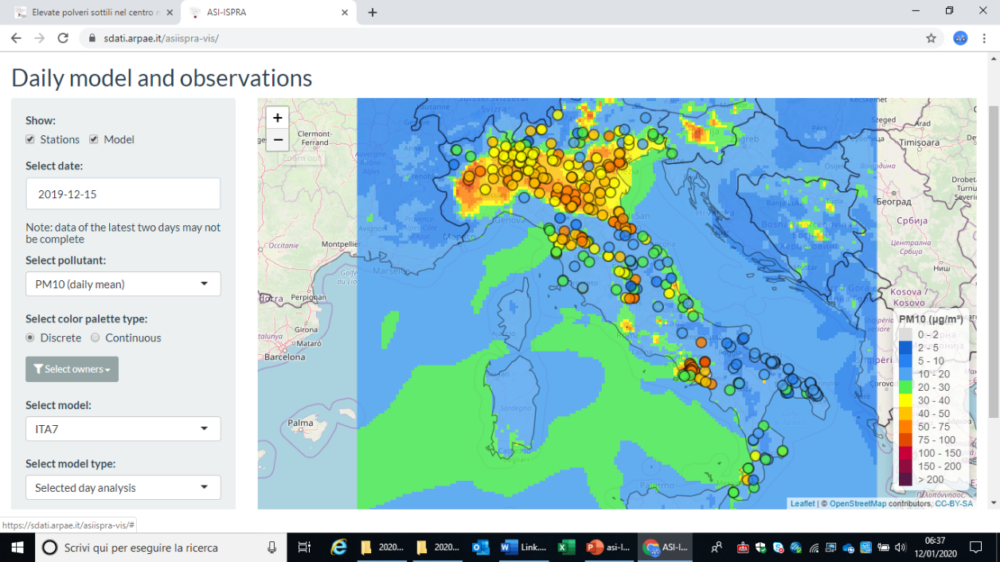
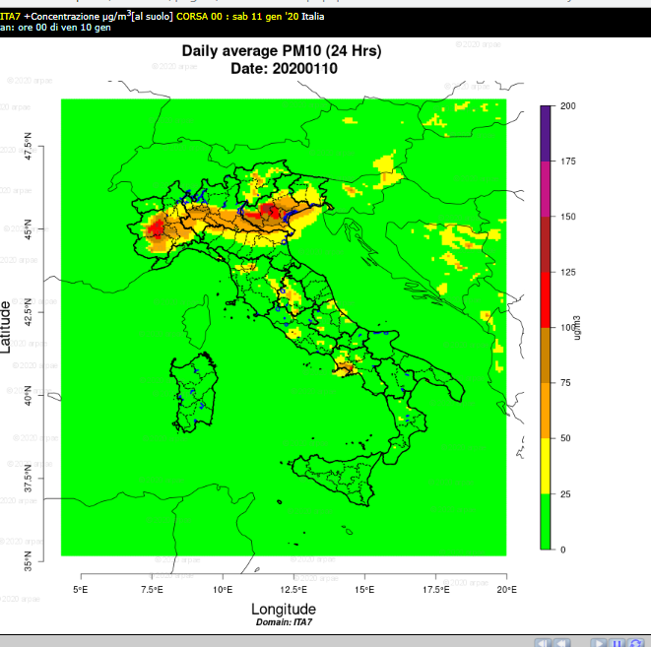
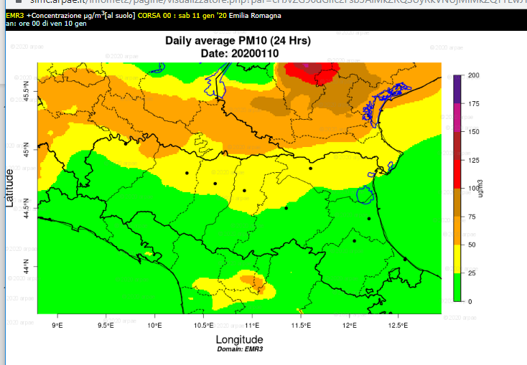
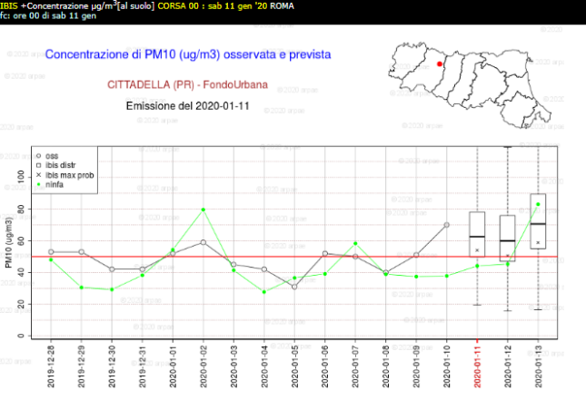

FRAMEWORK
Elements necessary for environmental agencies to carry out their institutional tasks in the field of air quality are:
Data insitu (fixed stations)
assessment of the spatialized concentration of pollutants on the ground for the entire national territory
daily forecasts (for the management and prevention of episodes of high pollution (short-term plans)
scenario analysis for the preparation of long-term improvement plans
https://sdati.arpae.it/asiispra-vis
To ITA-7
T0 Ninfa ER
Reanalysis (national scale)
By ASI ISPRA AIR QUALITY
INPUT (in situ and remote sensing data):
- Pollutants concentrations (CAMS)
- Meteorology fields (COSMO/MED)
- Emission inventory
- Land cover/use
PROCESS:
- CHIMERE (Photochemical Eulerian transport model)
Spatio-temporal modelling
OUTPUT:
Air quality numerical data over Italian domain to use by ARPAs to regional model
Notes:
The elements necessary for environmental agencies to carry out their institutional tasks in the field of air quality where Remote sensing data concerning atmospheric pollutants are used, in combination with in situ data, to obtain information on the spatial structure of the pollution.
Other useful RS data are related to meteorology, land cover and polluting sources, these data are used to improve the input and therefore the accuracy of the Chemical Transport Models.
All these elements are implemented in the ASI ISPRA AIR QUALITY Project to design the National AQ Operational Service….

Slide 5









AQ operational service
National Air Quality operational monitoring service has been identified by Institutional users as useful to respond to the National and European obligation and to monitor national asset (in the framework of the National Italian Initiative namely ‘Space economy plan – Mirror Copernicus Programme’ )
European Green Deal
Ambient Air Quality Directive 2008/50/CE
D.Lgs. n° 155 del 13/8/2010 e ss. mm
Zero pollution action plan EU
Directive 2001/81/CE (NEC) national emissions of atmospheric pollutants
short-term actions plans
(i.e. Turin, Po Valley)
Institutional users
(Buyers Group)
Air Quality plans by regions
Direttiva 2004/107/CE
Infrazione 2015/2043 per il superamento VL NO2
Sentenza 10/11/220 per il superamento VL PM10
Casa Italia

Slide 6
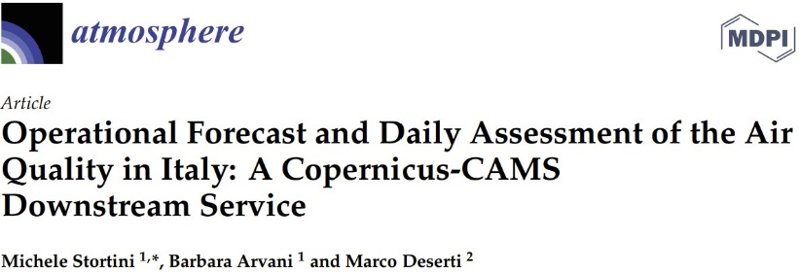
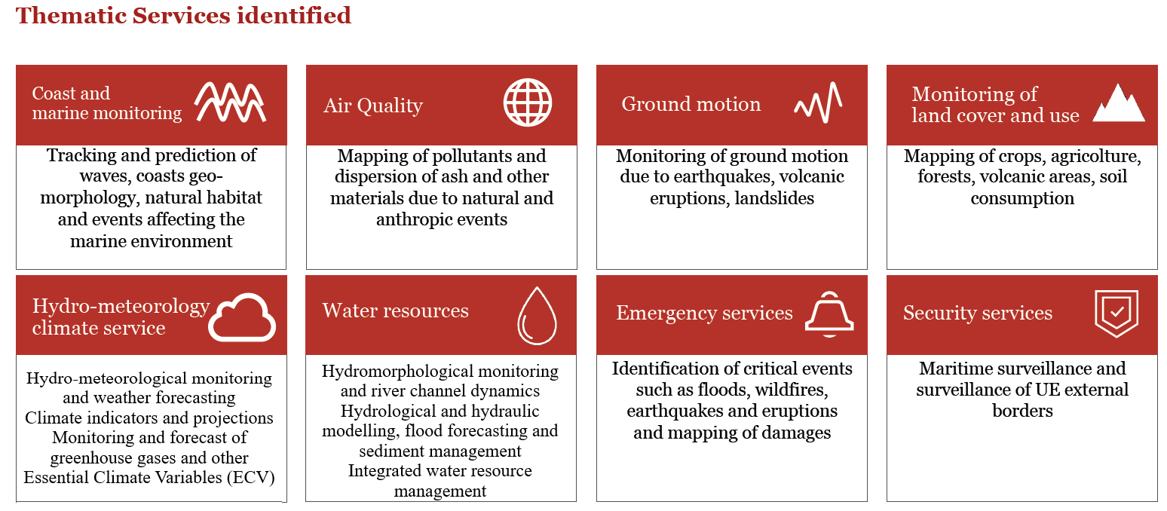
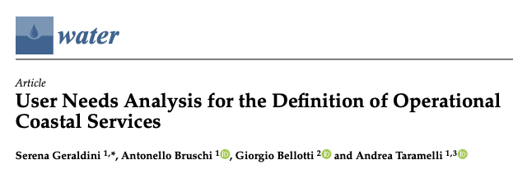

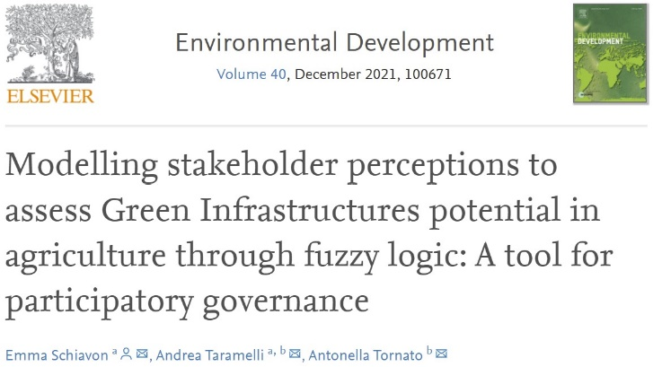
National operational service
By the National Copernicus User Forum Consultation Boards
Notes:
This service is one of the 8 National operational Services designed in the Italian Space Economy initiative, by the National Copernicus User Forum Consultation Boards. The National Copernicus User Forum is composed by Public, Research and Commercial (Industries and Enterprises) User Communities Representatives. The consultation boards permitted to address the design of the national operational monitoring services useful to respond to the National and European obligation and to monitor specific national asset that are affected by specific environmental conditions or exposed to different risk factors.

Slide 7
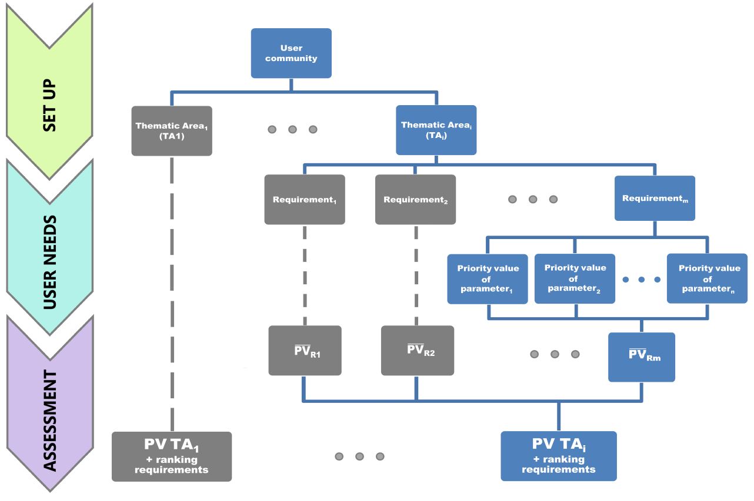
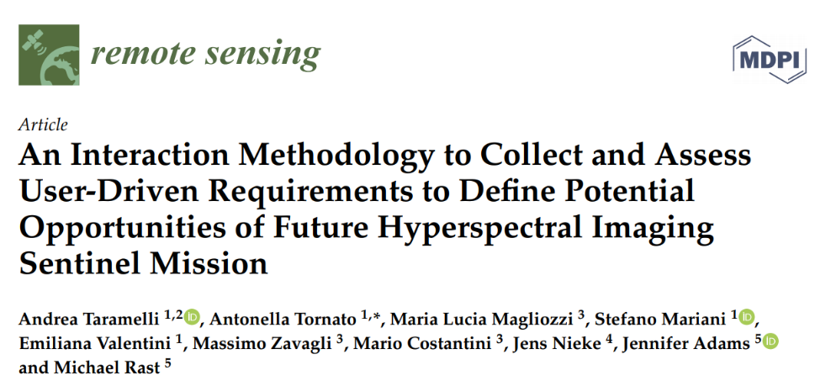
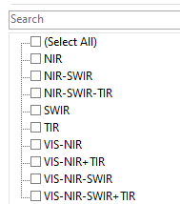
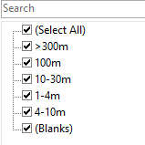
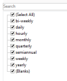
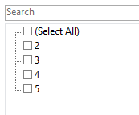
Example of environmental needs
National User Communities engagement by Interaction Methodology (processing)
The requirements and parameters emerged through the interaction with individual users (in the Buyers Group) engaged
to identify common needs and to define the thematic operational services
Operational requirements
Technical requirements
First results have been published in 2020
https://www.mdpi.com/2072-4292/12/8/1286
Notes:
The National User Communities are involved by an Interaction Methodology. For instance, for air quality domain each user identified for operational requirements the specific technical requirements.

Slide 8

ECMWF and Italian CoPernicus Mirror Programme
ECMWF has been entrusted by the European Commission with the implementation of the:
Copernicus Atmosphere Monitoring Service (CAMS) and,
Climate Change Service (C3S)
for the period 2014-2020 and 2021-2027
ECMWF contributes as well to the Copernicus Emergency Management Service (CEMS).
Italian Government and ECMWF, recognising has unique expertise in the fields of atmospheric composition and climate, as well as on the management and delivery of operational environmental services, are going to sign a Memorandum of Understanding recognising mutual benefits for the Parties to co-operate in the implementation of the Copernicus Mirror Programme (January 2022)

Slide 9

Players involved include
The role of ECMWF
R&D Development
Project Management
Research Institutes
ESA
ASI
MISE
Buyers Group
ECMWF
Industry
MARKET UPTAKE ADVISORY
R&D Development
Sets requirements for specific services, grouped in different Thematic Services, in accordance with their institutional goals and legislative provision
Notes:
The role of ECMWF is market uptake advisor for the set of services identified by Buyer Group.

Slide 10
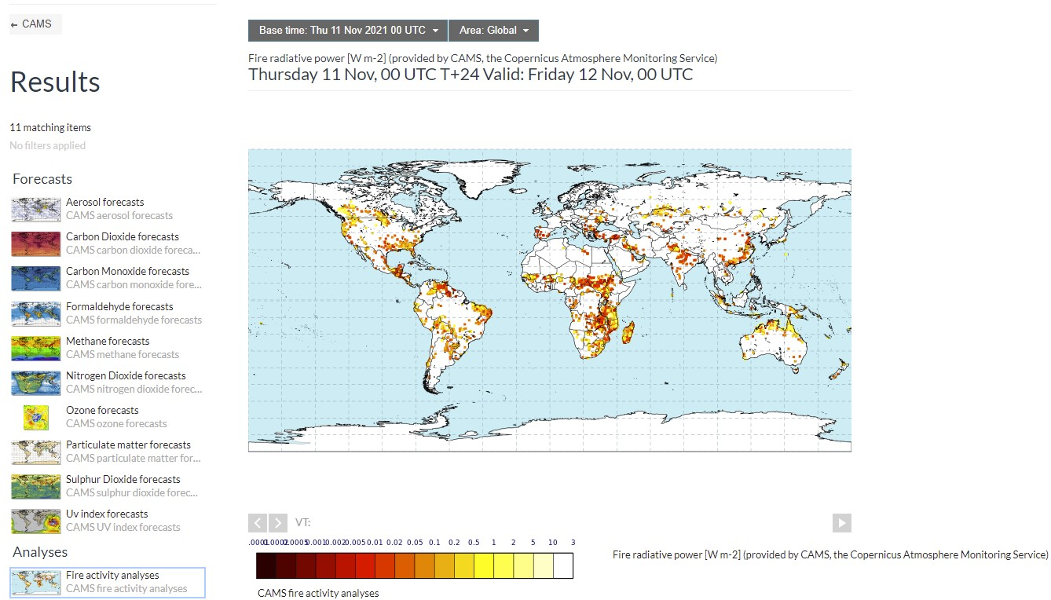
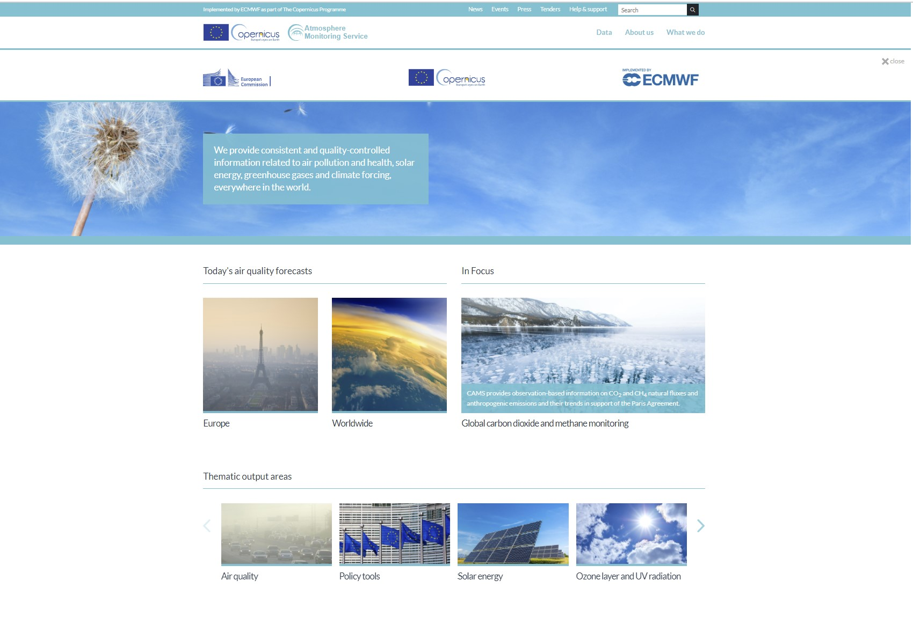
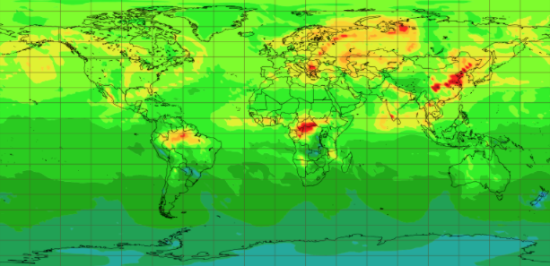
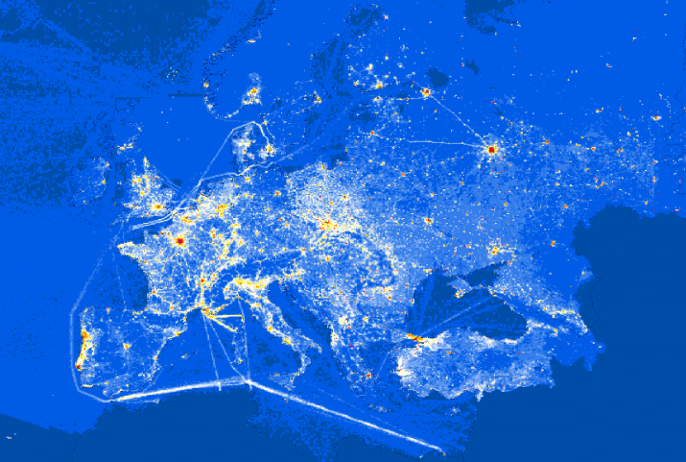
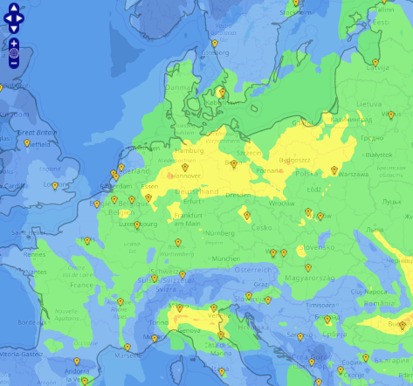
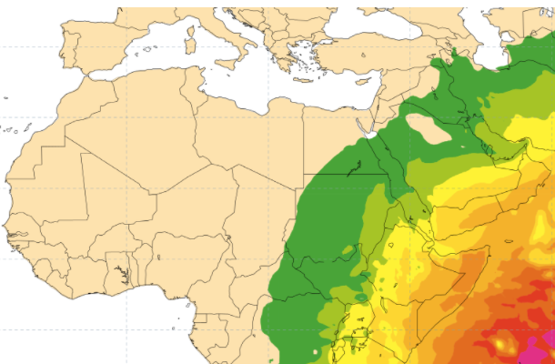
Copernicus Atmosphere Monitoring Service (CAMS)
Fire activity analyses
http://atmosphere.copernicus.eu
Global analyses, forecasts and reanalyses:
Reactive gas
Aerosol
CO2
Emissions and surface fluxes
European Air Quality
Solar radiation and UV index
Ozone layer
Notes:
Here there are some few examples of the provided products from CAMS. It's important to underlying that there is value added information based on satellite data and in-situ data, from the collaboration with the European Space Agency (ESA) and the European Organisation for the Exploitation of Meteorological Satellites (EUMETSAT).

Slide 11
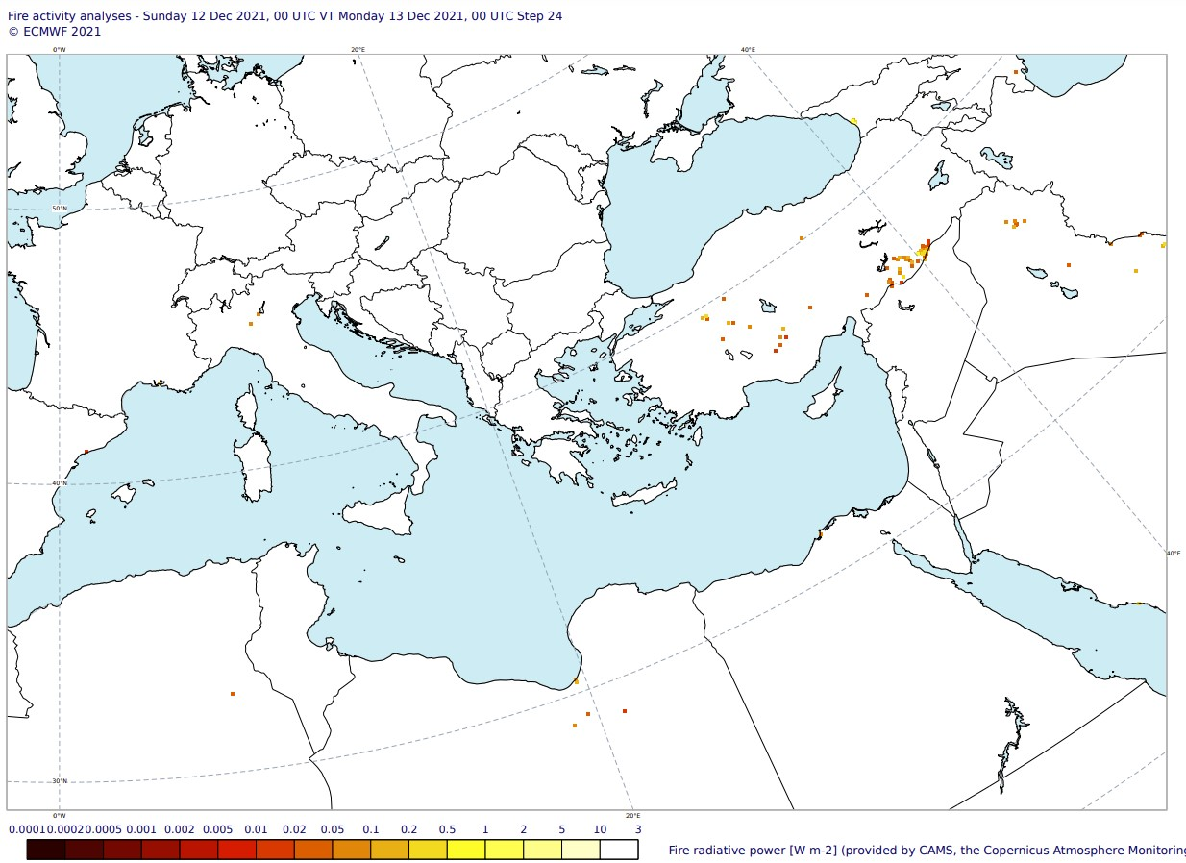
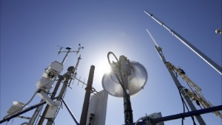
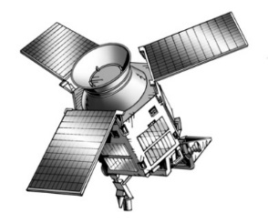

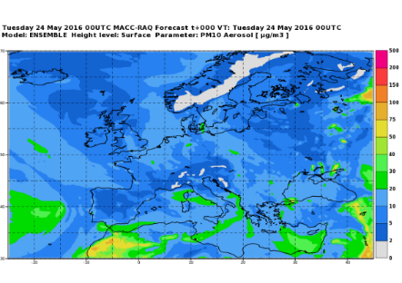
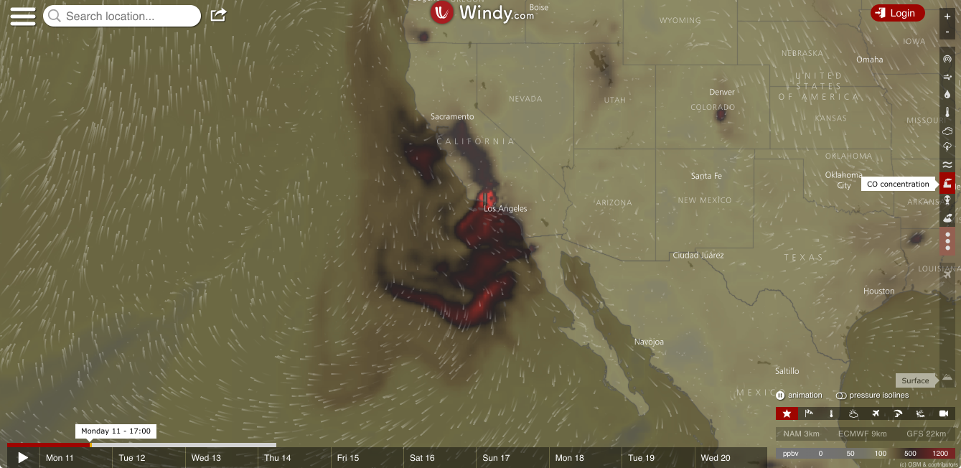
Development downstream services
By CAMS SERVICE CHAIN
In-situ observations
Space Agencies
ECMWF Fire radiative power
Regional multi-model ensemble (lead: Météo-France)
Users
Notes:
monitoring air quality and, for this specific case study estimation of wildfire atmospheric emissions with Copernicus data we need to combine global observations and models providing daily biomass burning emissions of various aerosol/greenhouse gas and chemical species based on Fire radiative Power (FRP) satellite observation and in situ data

Slide 12
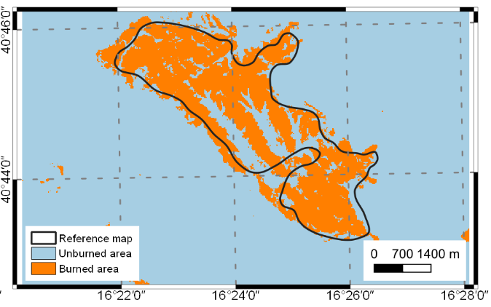
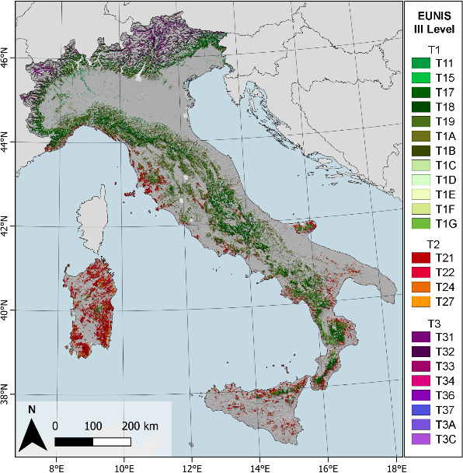
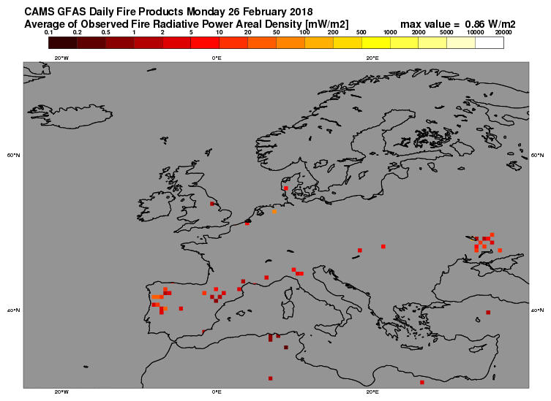
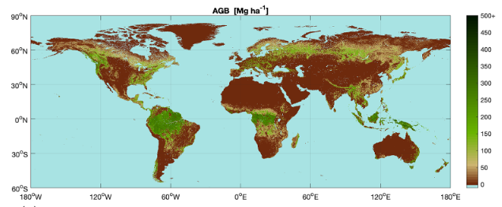
WILDFires impact on air quality
Earth Observation downstream services
Monitoring of natural hazards
Wildfire impact
on air quality
Atmospheric emission estimates
CO2 CH4 CO N2O NOX PM10 PM2.5 NMVOC SO2 Dioxin NH3 PAH BC
Green House Gases
EARTH OBSERVATION CONTRIBUTION TO WILDFires MONITORING
+
+
+
=
Burned Area Mapping
Forest and natural cover mapping
Fire Radiative Power (FRP)
Above Ground Biomass (AGB)

Slide 13
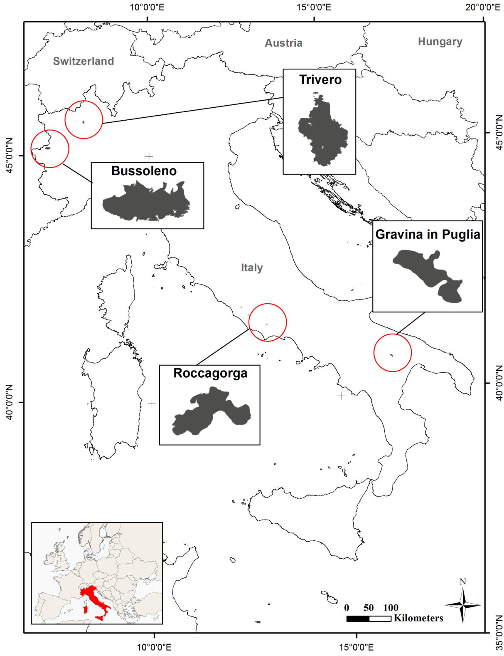
BURNED AREA MAPPING
1/4
CASE STUDIES IN ITALY
The procedure was developed at local scale in Italy and four burned areas were chosen from the archive of fire events of year 2017 made available by the Carabinieri Forestali
(CUFAA, https://www.carabinieri.it/arma/oggi/organizzazione/organizzazione-per-la-tutela-forestale-ambientale-e-agroalimentare)
The study areas differ in environmental conditions (climate, lithology, geomorphology, vegetation), land use and fire season
Analysis of pre-fire and post-fire Copernicus Sentinel-2 L2A satellite acquisitions
Pre- and post-fire tiles, acquisition date and time
Study area | Tile name | Acquisition date | Acquisition time | Satellite
Bussoleno | T32TLR | 2017-10-17 | 10:30:24 | S2A
 | T32TLR | 2017-11-21 | 10:33:23 | S2B
Trivero | T32TMR | 2015-11-24 | 10:23:39 | S2A
 | T32TMR | 2015-12-17 | 10:39:53 | S2A
Roccagorga | T33TUG | 2017-07-20 | 10:00:27 | S2A
 | T33TUG | 2017-07-30 | 10:05:35 | S2A
Gravina in Puglia | T33TXF | 2017-08-11 | 09:55:12 | S2B
 | T33TXF | 2017-08-18 | 09:40:28 | S2B
Notes:
Bussoleno and Trivero are situated in the Alpine mountain range. The fires events occurred on 2017 and 2015 respectively, both during the fall season and after an extended drought season. Roccagorga and Gravina in Puglia are situated in the Apennine mountain range and the fire events occurred during a harsh summer dry season in 2017

Slide 14
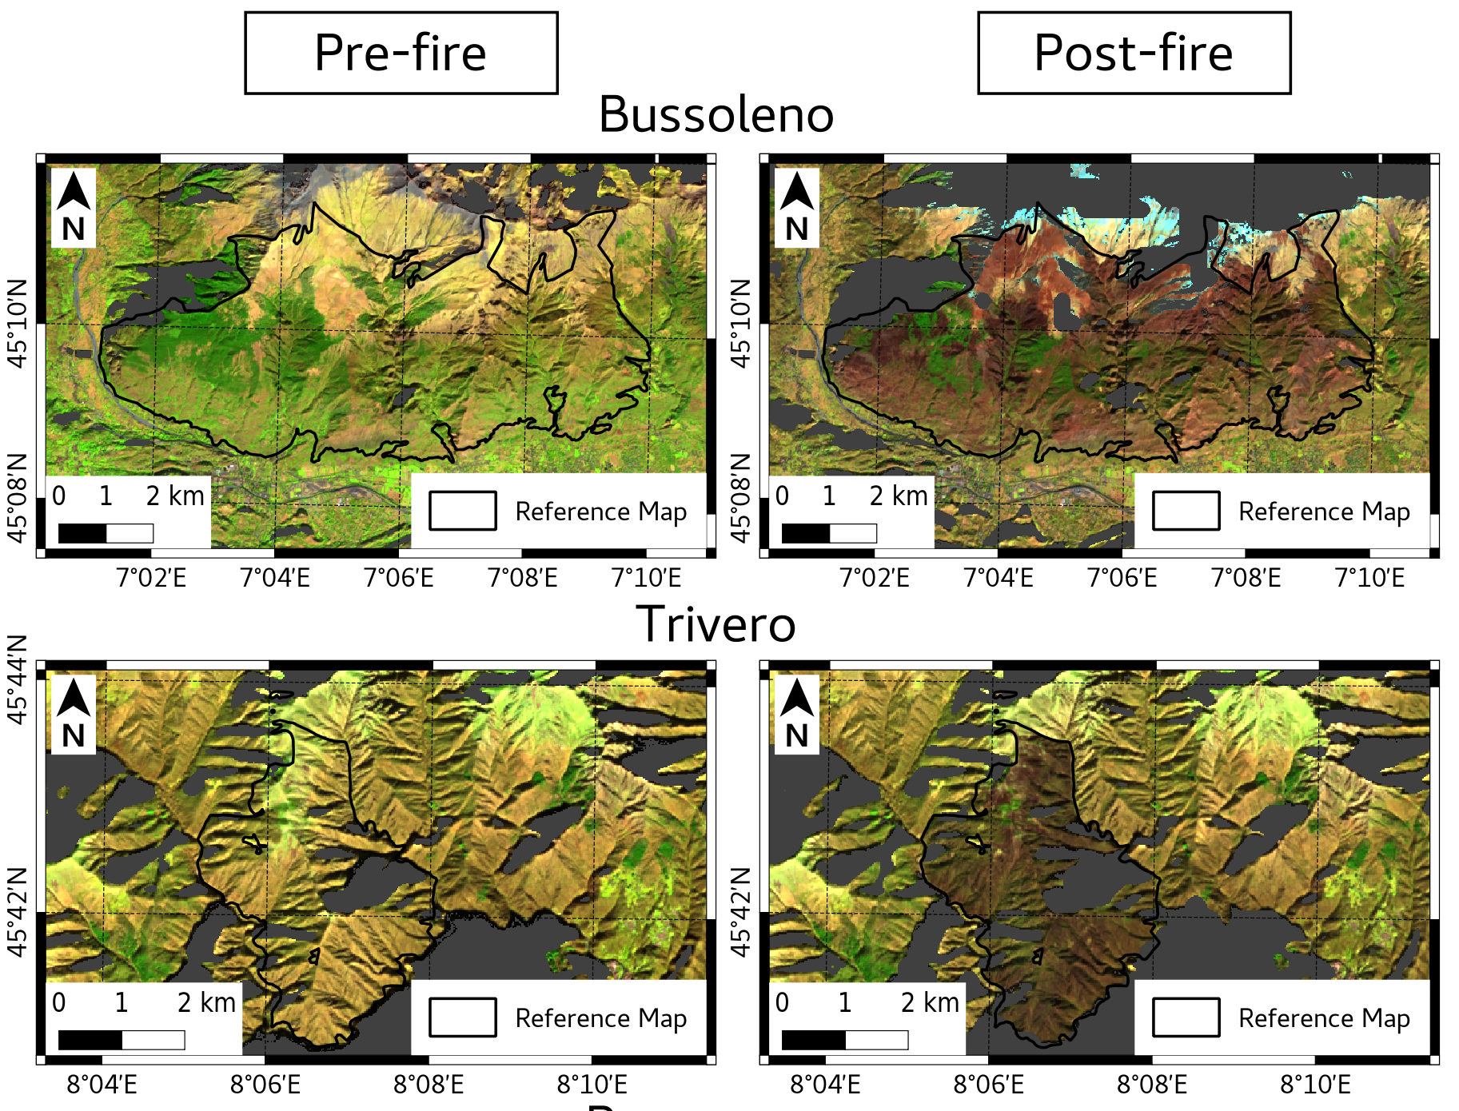
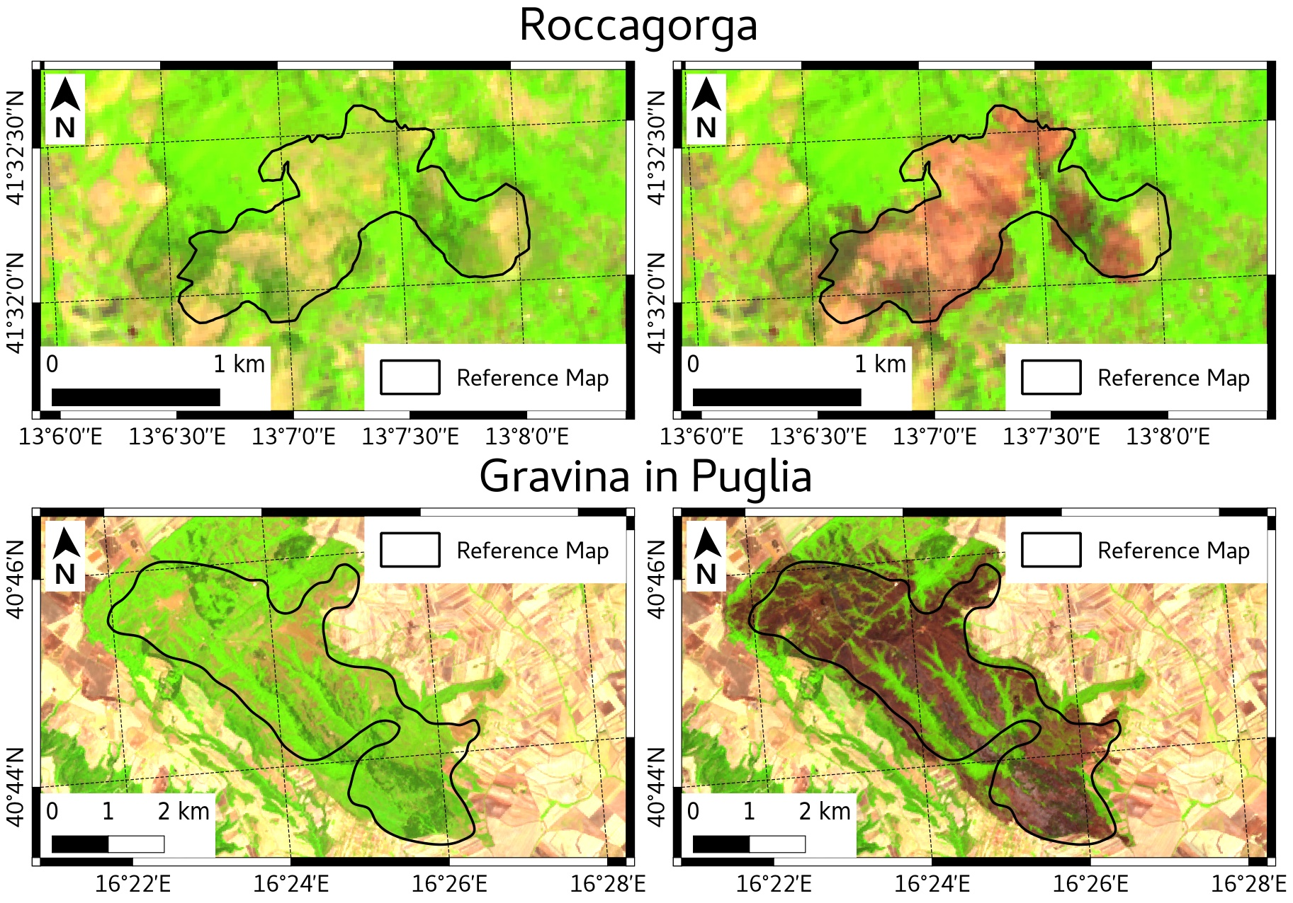
Earth Observation DATA – SENTINEL-2
2/4
Maps of pre-fire and post-fire Sentinel-2 MSI images displayed in false color (R: BOA reflectance at 1610 nm; G: BOA reflectance at 864 nm; B: BOA reflectance at 665 nm). Solid line represents the polygon contour of burned area reference map. Grey color represents areas affected by topographic shadow

Slide 15
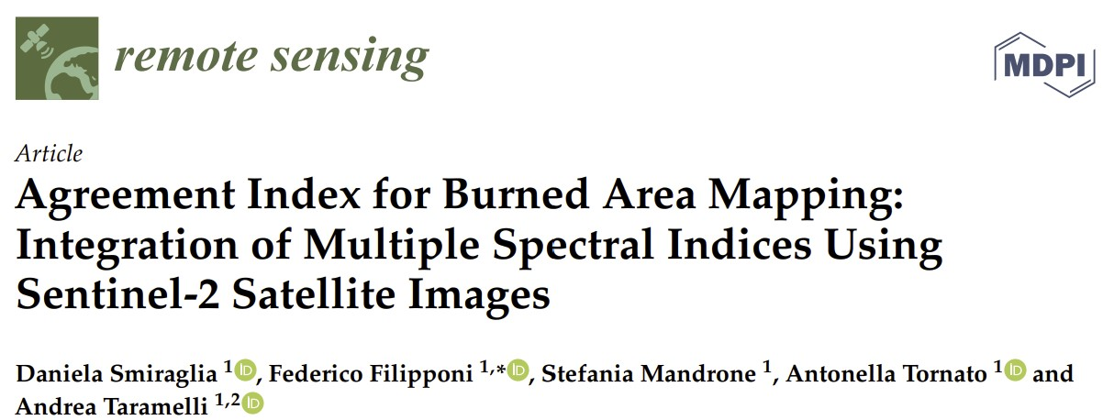
procedure for burned area mapping
3/4
Spectral indices adopted, equations with Sentinel-2 MSI bands and bibliographic references
Use of Difference spectral indices:
dNBR = NBR _{post-fire} – NBR _{pre-fire}

Slide 16
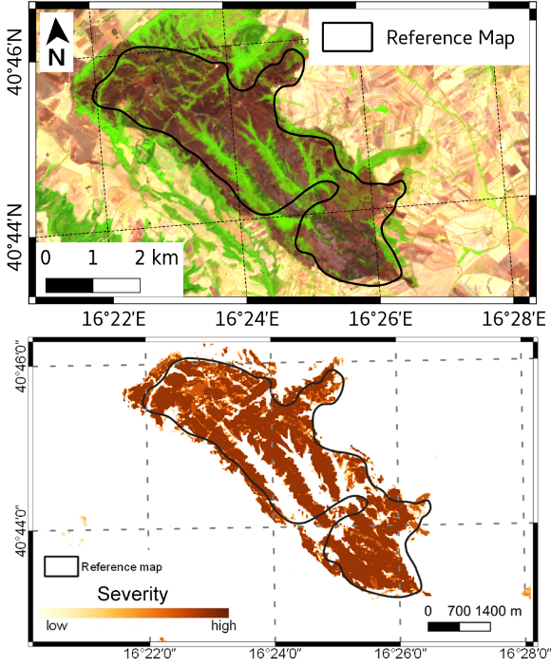

CASE STUDY: gravina in Puglia (2017)
4/4
Burned area map
from spectral indices integration
Omission Error: 0.24300
Commission Error: 0.22162
Overall Accuracy 0.93180
Burned areas for the case study are characterized by natural grasslands, shrublands and broadleaved forests
Burned severity estimated from the combination of burned area mapped from various difference spectral indices
Single index burned area maps

Slide 17
Thank you for the attention
Contacts:
Antonella Tornato – antonella.tornato@isprambiente.it
Federico Filipponi – federico.filipponi@isprambiente.it
Andrea Taramelli (Italian Copernicus User Forum coordinator) – andrea.taramelli@isprambiente.it
Marco Deserti (Head of the water, air and physical agents protection and remediation service of the Emilia-Romagna Region and Scientific Coordinator of the ASI-ISPRA QA project) – Marco.Deserti@Regione.Emilia-Romagna.it

